Slide 1
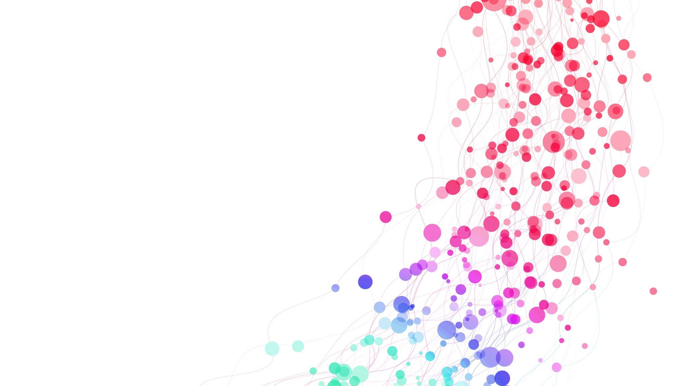
Customer Perception Analysis Using Deep Learning and NLP
Presented by Md Rakibul Islam ID:20301373

Slide 2
Introduction
Importance of understanding customer perceptions for business success
Focus on analyzing unstructured data, including text from social media, surveys, voice recordings, and chat transcripts
Utilization of Deep Learning (DL) and Natural Language Processing (NLP) technologies for insights

Slide 3


Contribution
Introduction of DL and NLP for effective customer feedback analysis
Exploration of the possibility of understanding and extracting customer concerns and reasons
Illustration using a dataset of car reviews to demonstrate the application

Slide 4
Methodology
Analytical exploration of NLP and DL for meaningful insights from Customer Perception (CP)
Query: Can customer concerns and reasons be solely understood using DL/NLP?
Dataset: Car reviews dataset for in-depth analysis of customer experiences

Slide 5
Conclusion
Emphasis on the business impact of customer perceptions in marketing and product quality
Challenge of scrutinizing large volumes of unstructured text data for valuable insights
Aim to understand CP using NLP and DL for better adaptation to customer expectations

Slide 6
Customer Perception (CP)
Categorization of customer experiences into three main categories: sentiments, sentiments with reasons, CP reasons
Argument for the importance of understanding CP reasons for actionable insights
Concentration on analyzing the text of reasons and reviews

Slide 7
Natural Language Modeling for CP
Review of the traditional NLP pipeline for understanding text
Acknowledgment of limitations in basic NLP processing for business analysis
Challenges in interpreting complex and domain-specific datasets

Slide 8
Rule-Based Semantics Annotation
Proposal for rule-based semantics annotation to enhance NLP processing
Emphasis on understanding the business intention behind collecting customer feedback
Identification of Named Entity Recognition (NER) as a crucial step

Slide 9

Synthesis
Exploration of DL and NLP intersection for effective customer feedback analysis
Focus on understanding CP reasons for actionable insights
Practical example using a car reviews dataset to illustrate challenges and potential solutions in interpreting customer feedback

